Slide 1
Data-Driven Approaches vs. Hypothesis testing

Slide 2
Why do we care about phylogeny?

Slide 3
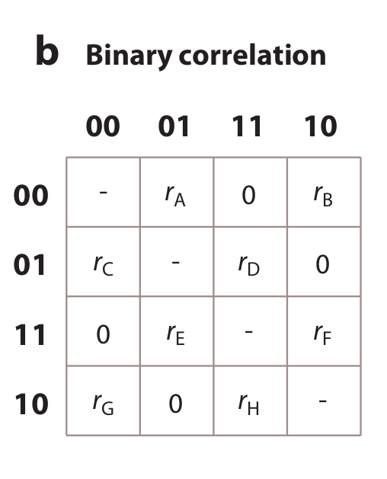
Discrete Character Correlations
Pagel's Method (1994)
If we can reject all of:
rB = rD, rE = rG, rA = rH, rC = rF
Then there is evidence that traits are correlated
Why?

Slide 4
“Phylogenies help us to identify independent evolutionary events, and it is independent events that statistical tests rely on”
Harvey and Pagel, 1991

Slide 5
Phylogeny introduces statistical non-independence

Slide 6
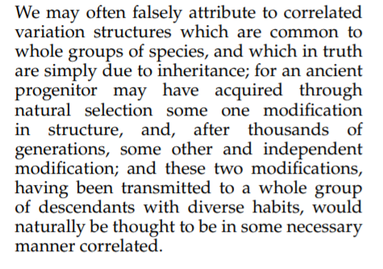

Slide 7
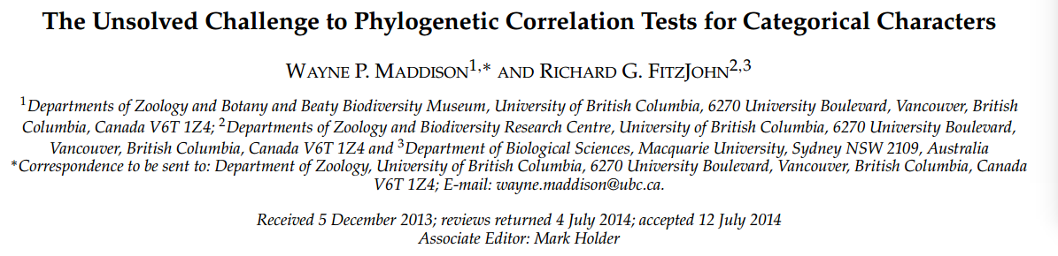
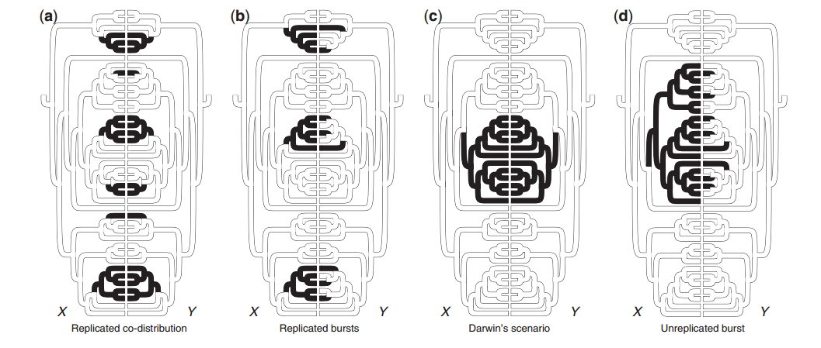

Slide 8
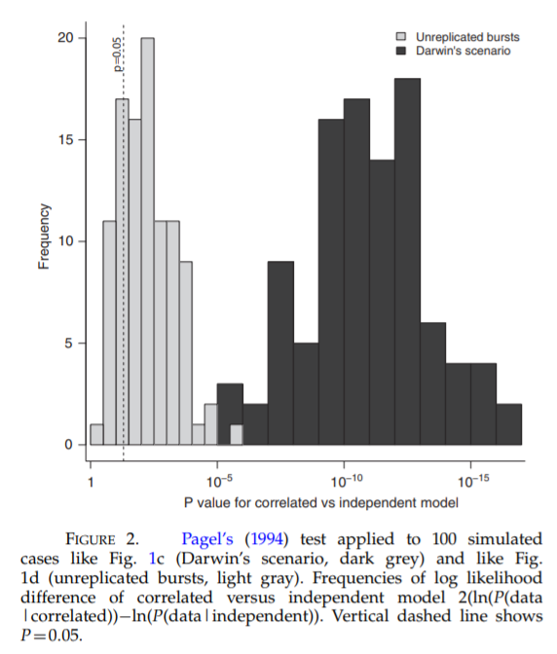

Slide 9
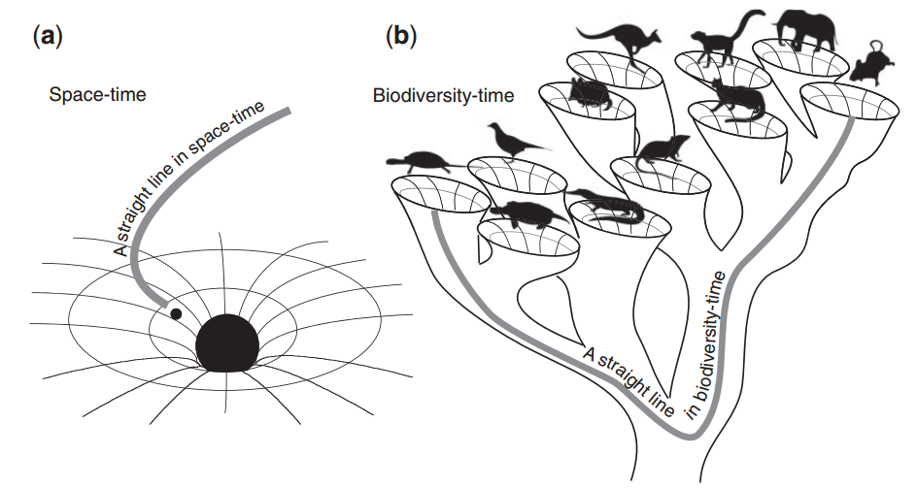

Slide 10
Rare, singular events break everything

Slide 11
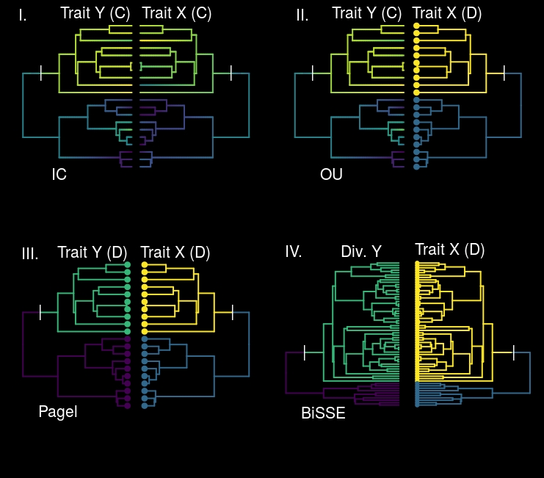

Slide 12
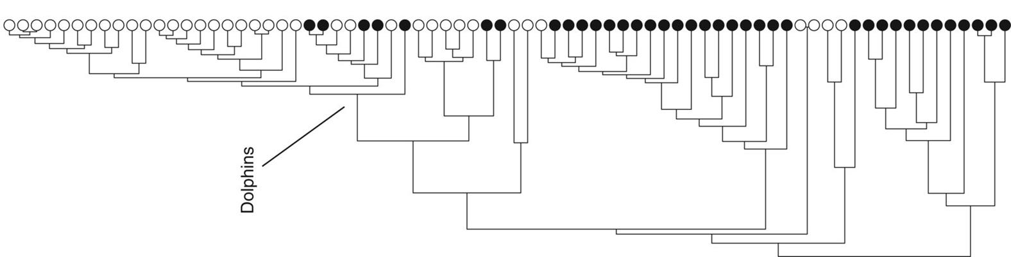
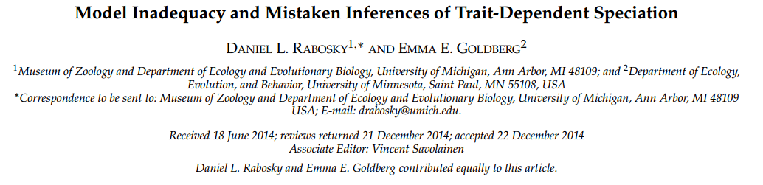
State-dependent Diversification
(SSE models, e.g. BiSSE)
77% of 400 datasets showed a significant association between speciation rate and taxon name length (!!!)

Slide 13
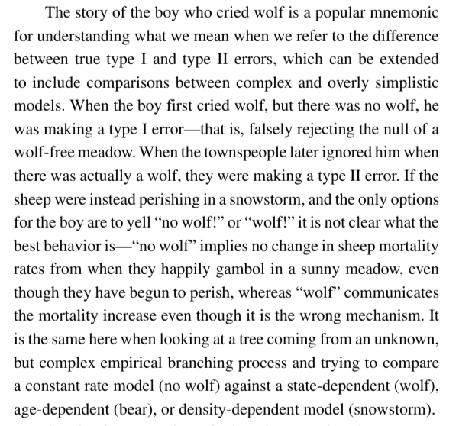
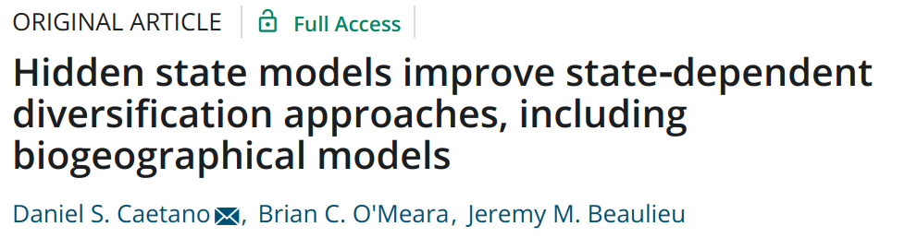

Slide 14
Beaulieu and O’Meara (2016)
Constant rate diversification
Vs.
Trait-dependent diversification

Slide 15
Beaulieu and O’Meara (2016)
Constant rate diversification
Vs.
Trait-dependent diversification
Vs.
Variable diversification independent of trait

Slide 16
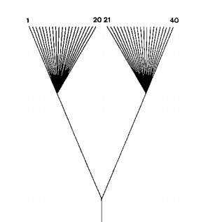
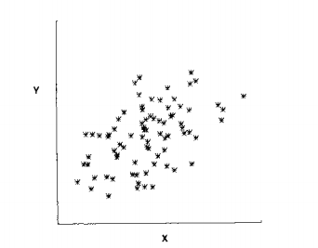
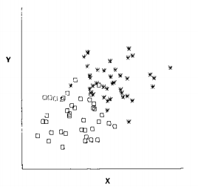
Case Study I.
Let’s revisit Felsenstein 1985…

Slide 17
Why can’t we do “regular” linear regression again?
Non-independence
of species

Slide 18
Y ~ X
X₀
X₁
X₂
X₃
X₄
X₅
X₆
Y₅
Y₆
Y₇
Y₈

Slide 19
Why can’t we do “regular” linear regression again?
Non-independence
of residual error variation

Slide 20
Y ~ X
E₀
E₁
E₂
E₃
E₄
E₅
E₆
Y₅
Y₆
Y₇
Y₈
X₃
X₄
X₅
X₆

Slide 21
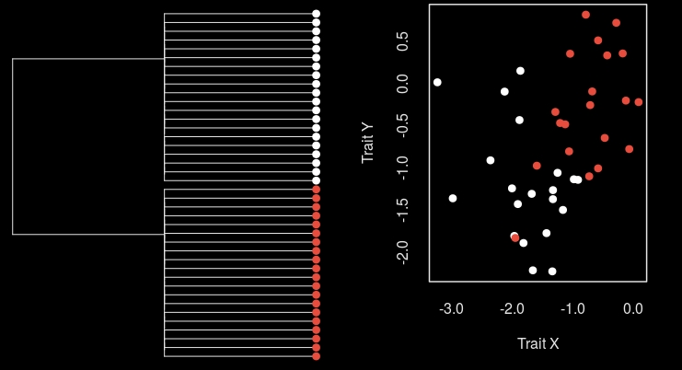

Slide 22
X₀
X₁
X₂
Y₀
X₃
X₄
X₅
X₆
Y₁
Y₂
Y₃
Y₄
Y₅
Y₆

Slide 23
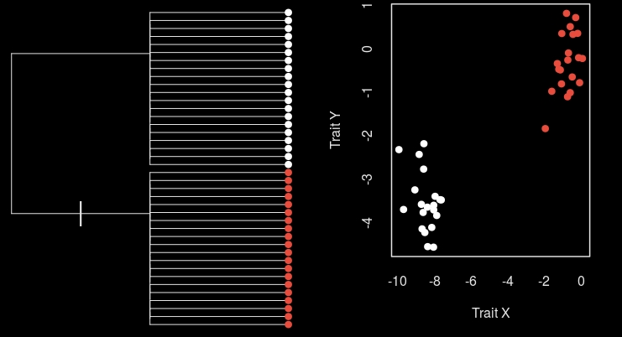

Slide 24
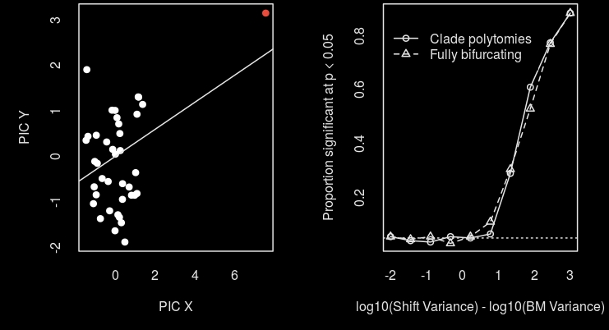

Slide 25
Outline
Rare singular events break everything
I. Felsenstein’s worst-case scenario
II. Models of adaptation
III. Discrete character correlations
B. We need to think about causation better

Slide 26
Two approaches
Hypothesis testing
Tests biological predictors
Best model may be still be bad
Phylogenetic natural history
Descriptive: “stuff happens”
Finds major events

Slide 27
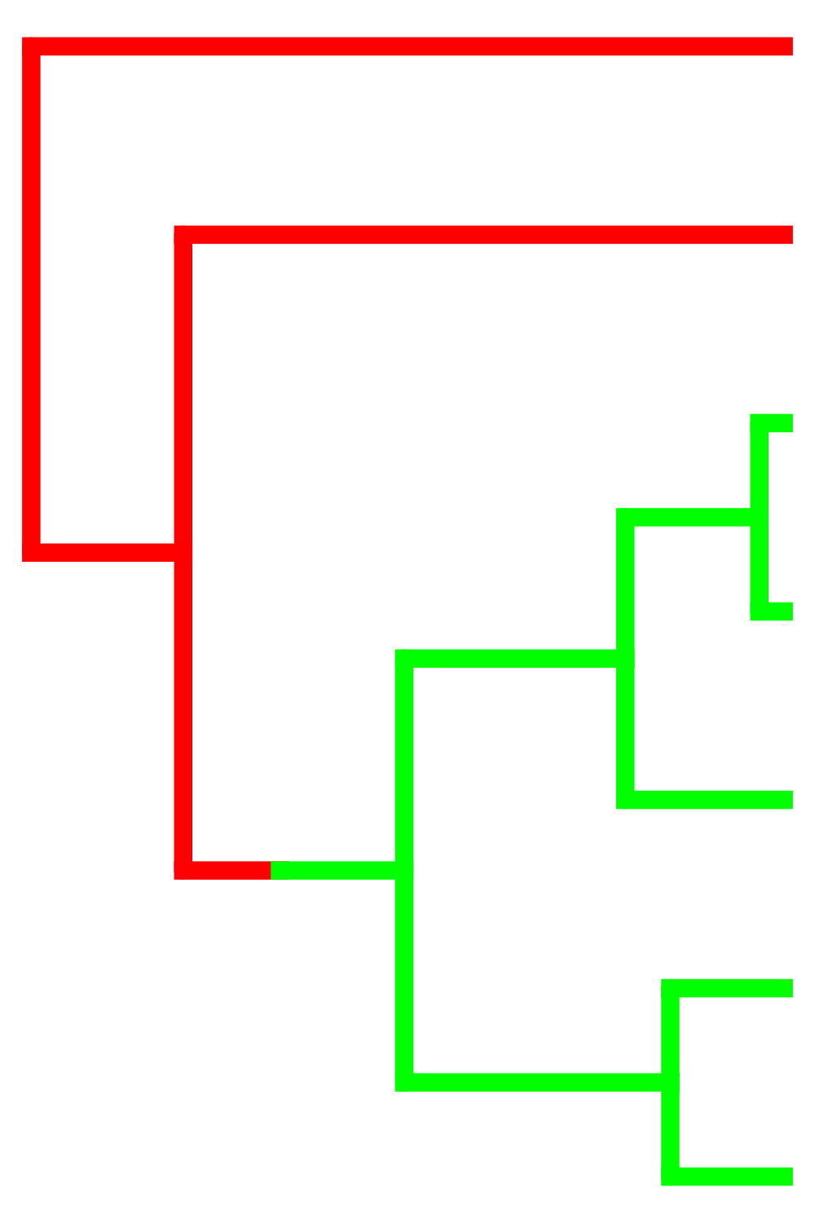
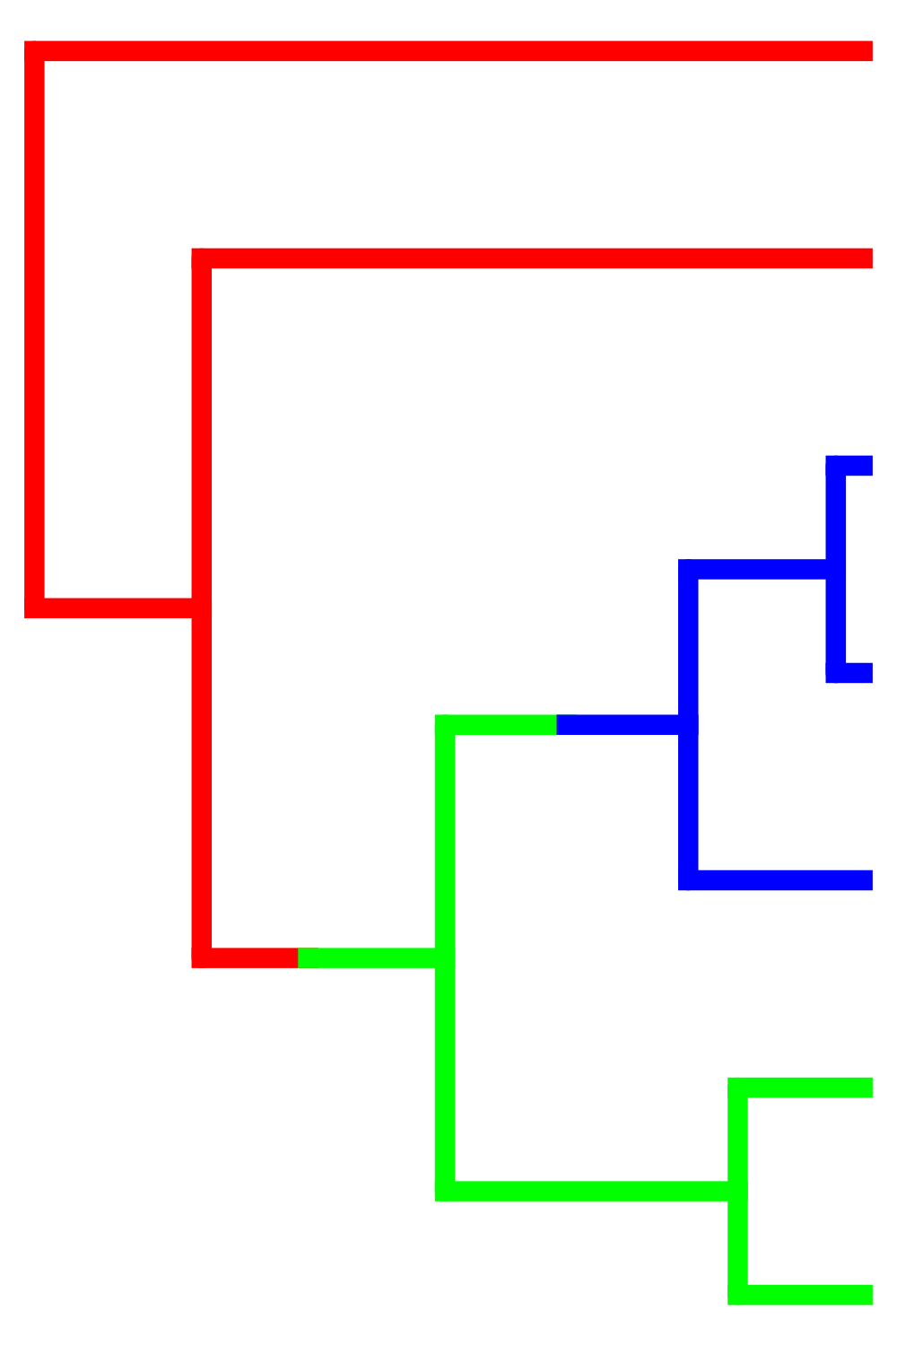
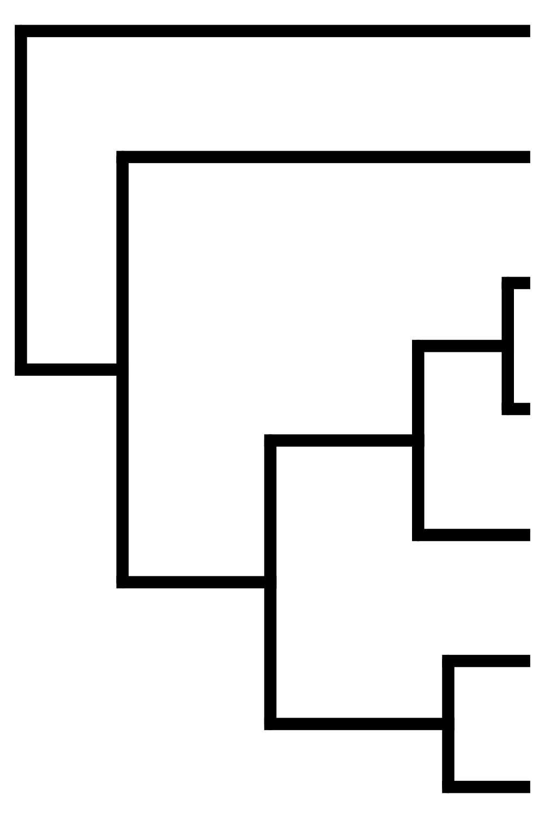











Slide 28



Slide 29
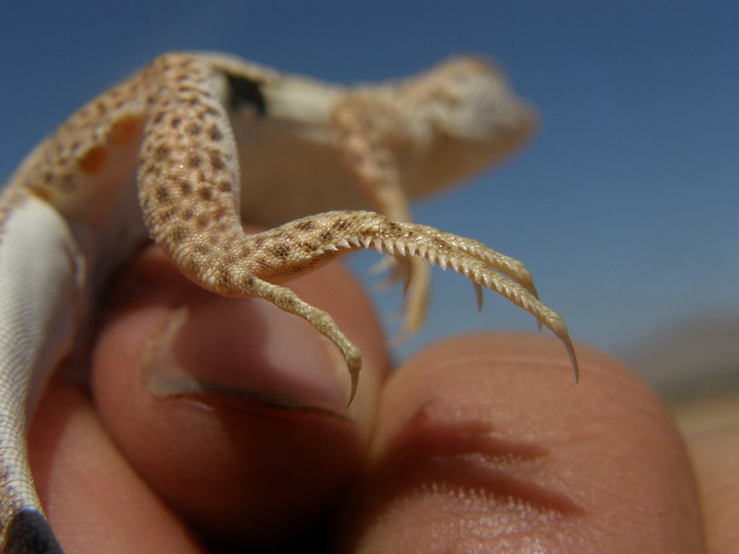
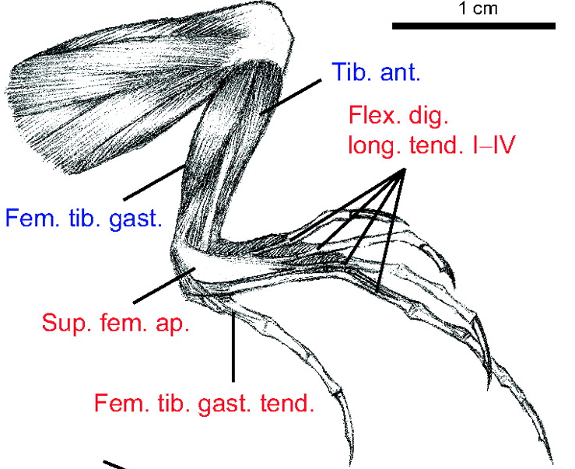
Lizard muscle fibers (Scales et al. 2009)

Slide 30
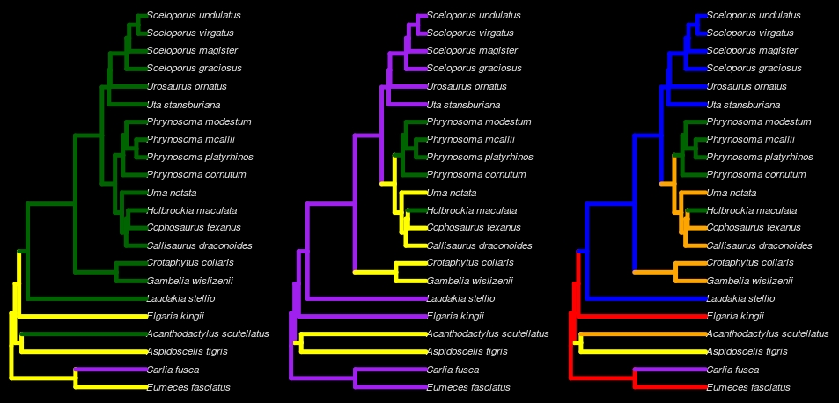
Predator Escape (PE)
FM & PE
Foraging Mode (FM)

Slide 31
Predator Escape (PE)

Slide 32
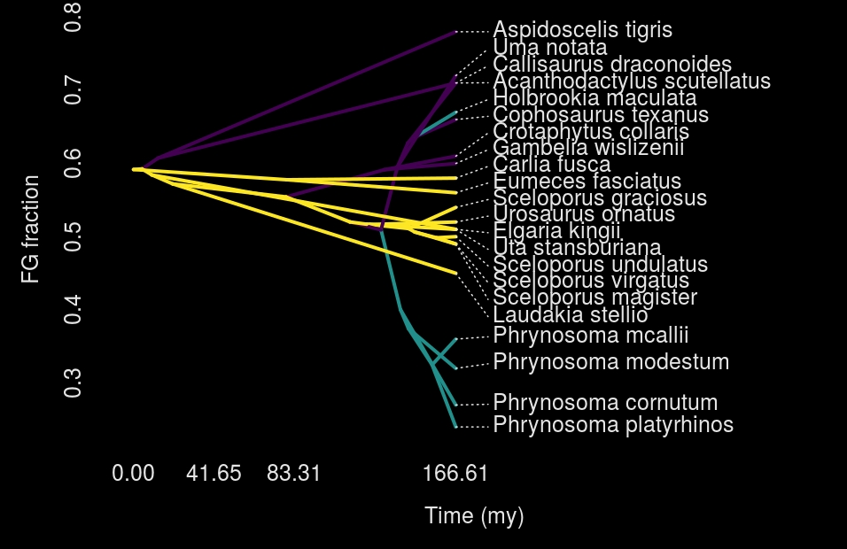

Slide 33
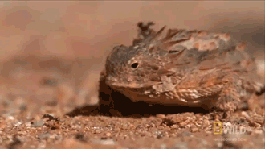
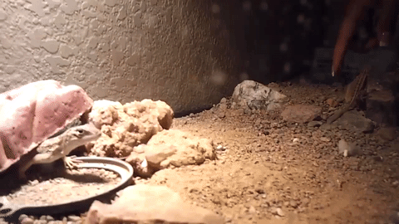
Vs.
Foraging Mode (FM)

Slide 34

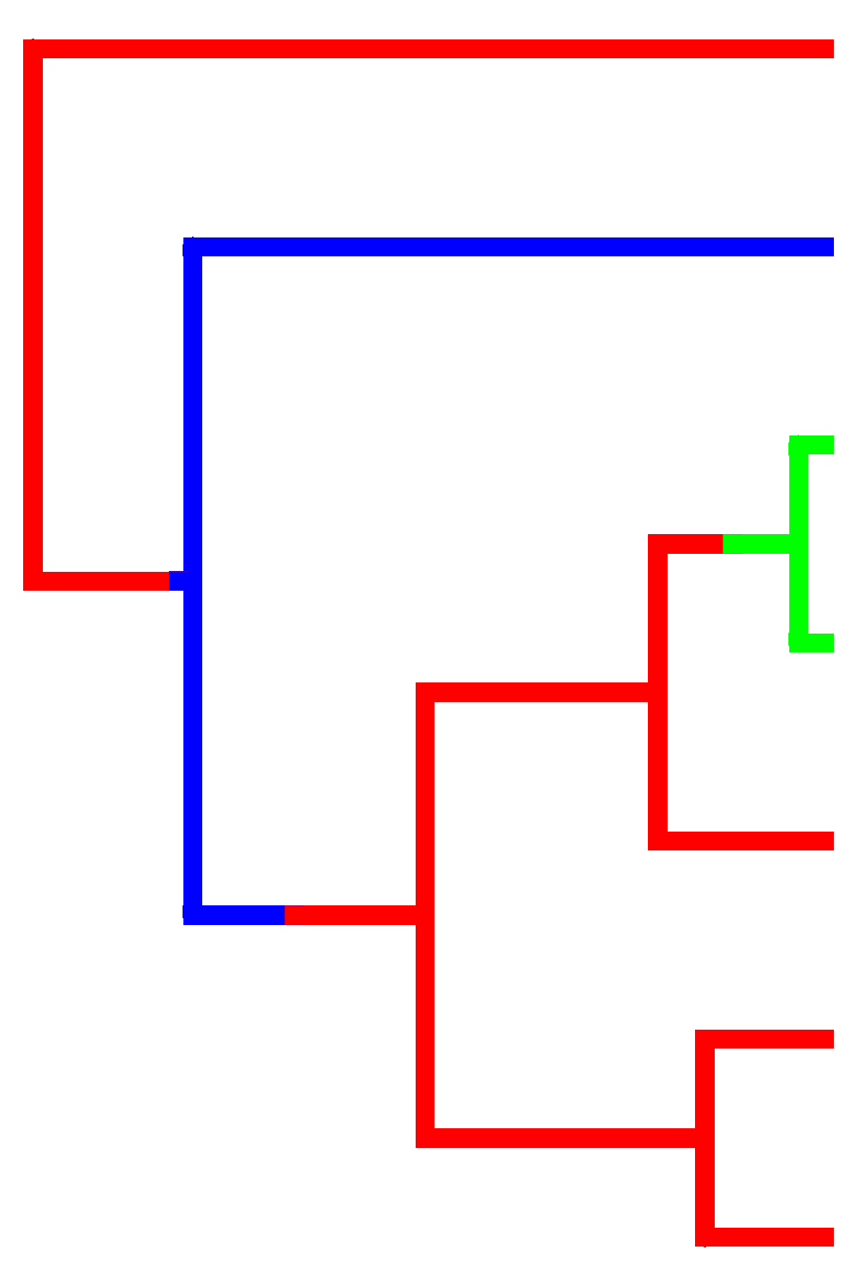
Combine approaches
W *
+ (1 – W) *
PE

Slide 35
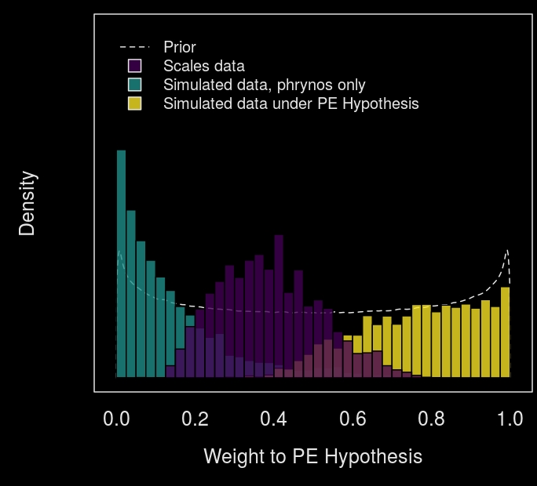

Slide 36
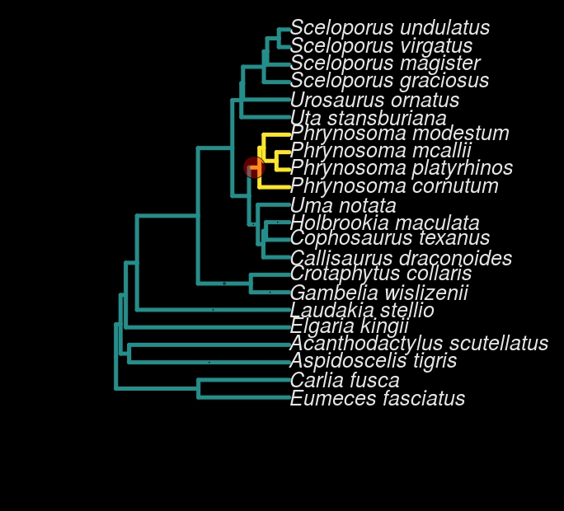

Slide 37
Combine approaches
0.4 *
+ 0.6 *
PE

Slide 38
Predator escape is a good predictor of muscle fibers in lizards!
…and horned lizards
are weird

Slide 39
Outline
Rare singular events break everything
I. Felsenstein’s worst-case scenario
II. Models of adaptation
III. Discrete character correlations
B. We need to think about causation better

Slide 41
All the above cases reduce to Darwin's scenario
*
*
*
*

Slide 42
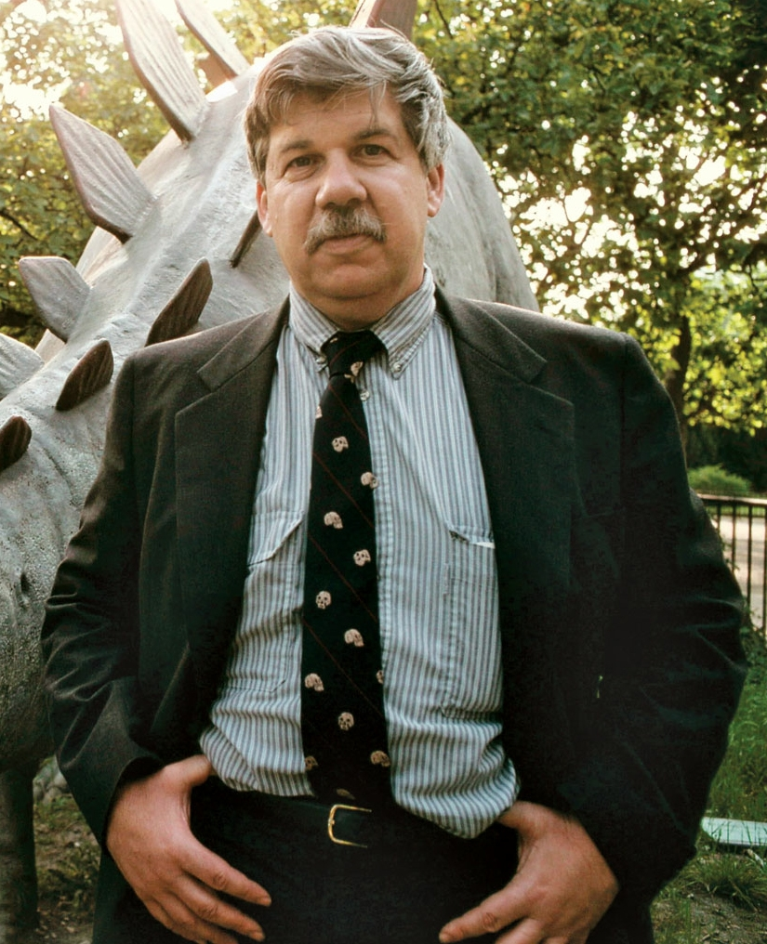
"Replaying the tape of evolution"

Slide 43
We can reduce “Darwin’s Scenario” to:
P( 1 event on branch i )
vs.
P( 2 events on branch i )

Slide 44
Length of Branch i
Total Branch Length of Tree
Length of Branch i
(
)²
Total Branch Length of Tree

Slide 45
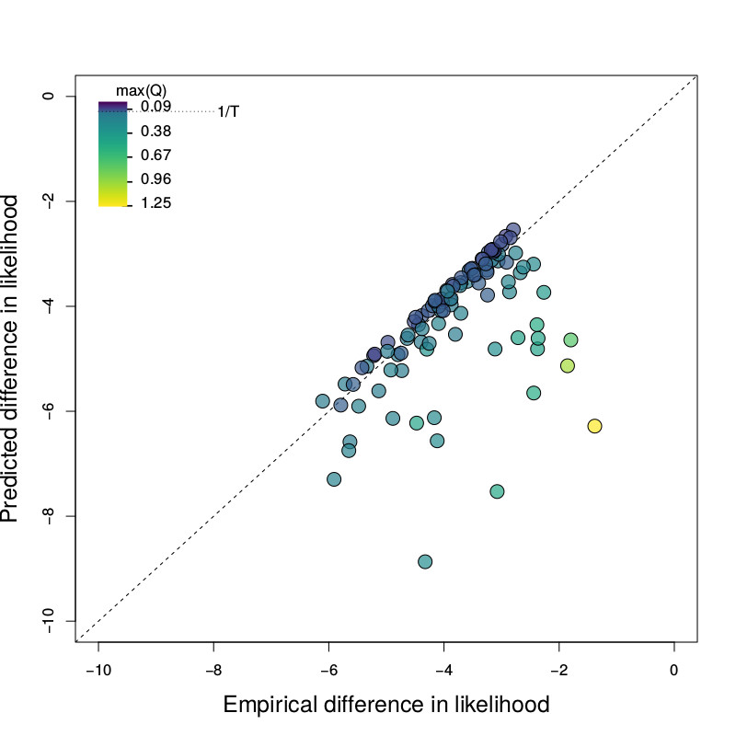

Slide 46
If traits were selected randomly, this would be OK, but ascertainment bias….

Slide 47
Conclusions
All comparative methods break with rare, singular events
We need to allow for background shifts and “phylogenetic natural history” models
“Darwin’s Scenario” is a boundary condition – gives hope

Slide 48
Outline
Rare singular events break everything
I. Felsenstein’s worst-case scenario
II. Models of adaptation
III. Discrete character correlations
B. We need to think about causation better

Slide 49
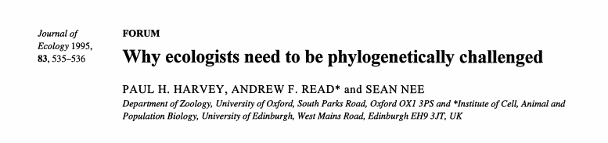
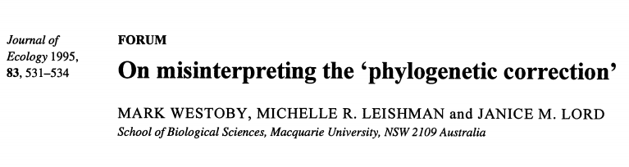
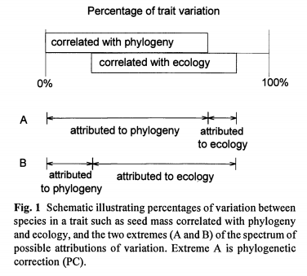
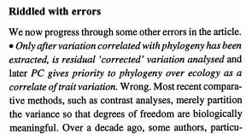
Old fights reborn…

Slide 50
Simpson's paradox
Male recovery rate
Drug: 60% (18/30)
No drug: 70% (7/10)
Female recovery rate
Drug: 20% (2/10)
No Drug: 30% (9/30)
Combined
recovery rate:
Drug: 50% (20/40)
No drug: 40% (16/40)

Slide 51
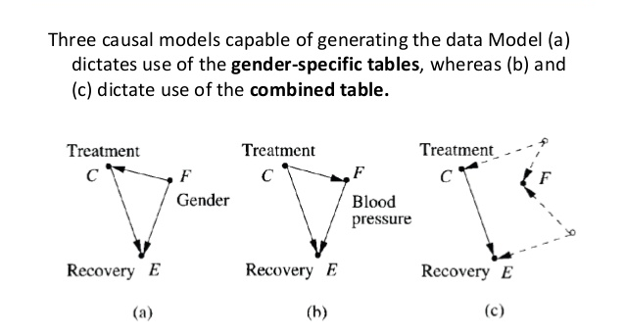
Causal interpretations

Slide 52
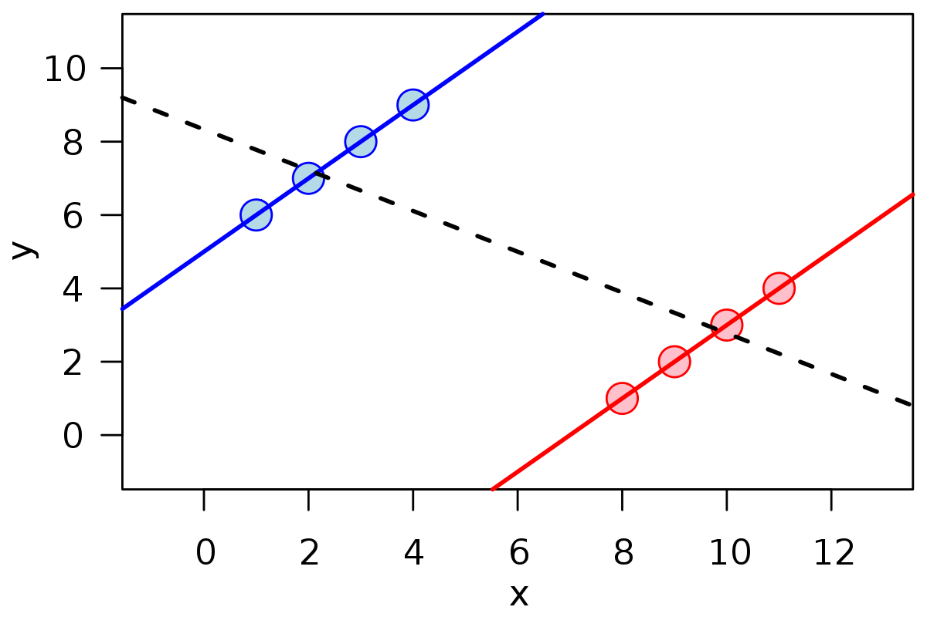
Simpson's paradox

Slide 53

ψ
Body Size
Mig.
Pop. N

Slide 54
Body Size
Mig.
ψ
Pop. N

Slide 55
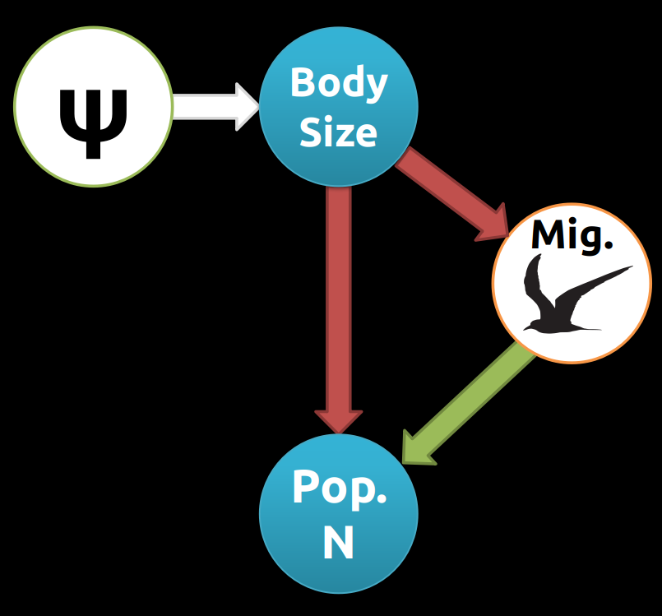
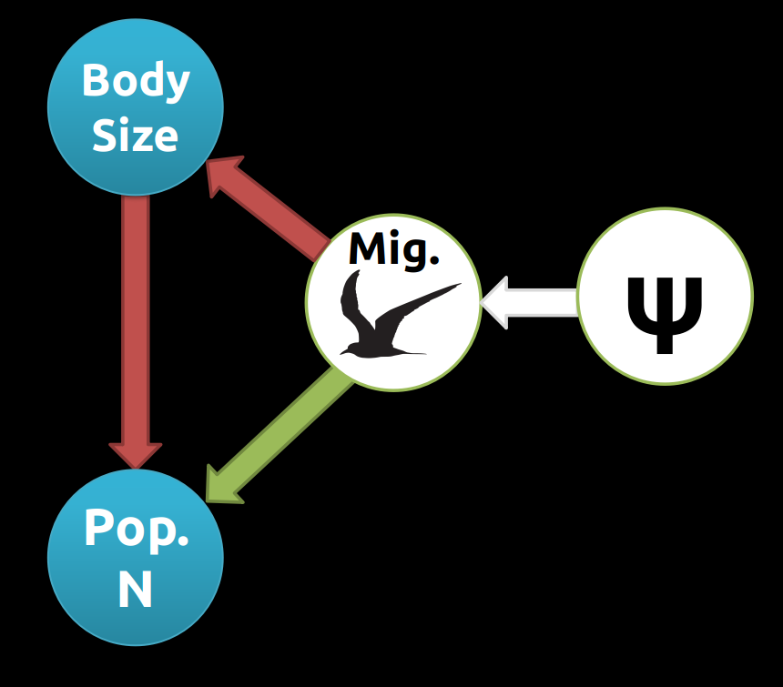
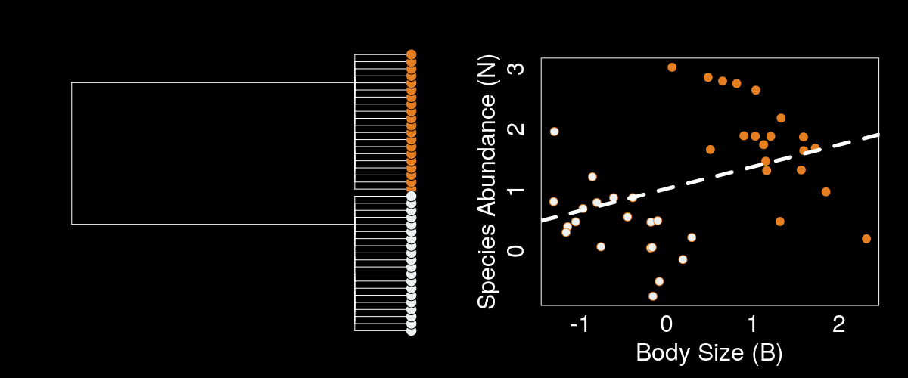
OLS

Slide 56
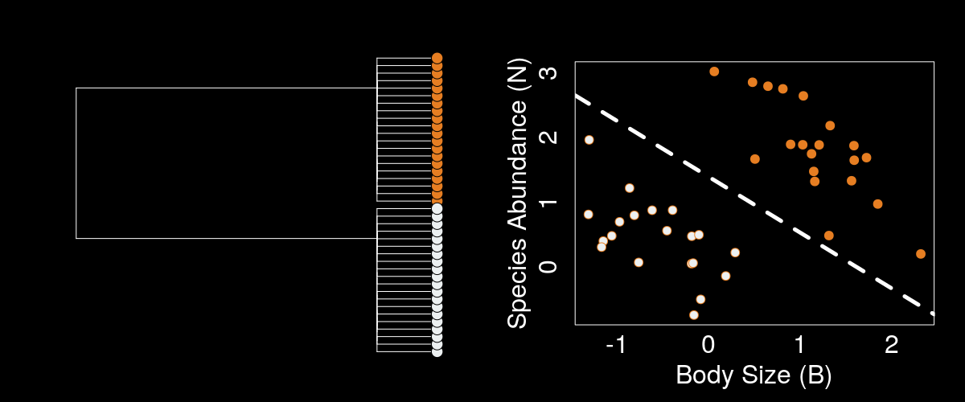
PGLS

Slide 57
Phylogenies are causal graphs

Slide 58
Y ~ X
E₀
E₁
E₂
E₃
E₄
E₅
E₆
Y₅
Y₆
Y₇
Y₈
X₃
X₄
X₅
X₆

Slide 59
SLOUCH (Hansen et al. 2008)
X₀
Y₀
Y ~ X
X₁
X₂
Y₁
Y₂
X₃
X₄
X₅
X₆
Y₃
Y₄
Y₅
Y₆

Slide 60
X₀
K ~ J
J
X₁
X₂
K
Y₀
X₃
X₄
X₅
X₆
Y₁
Y₂
Y₃
Y₄
Y₅
Y₆

Slide 61

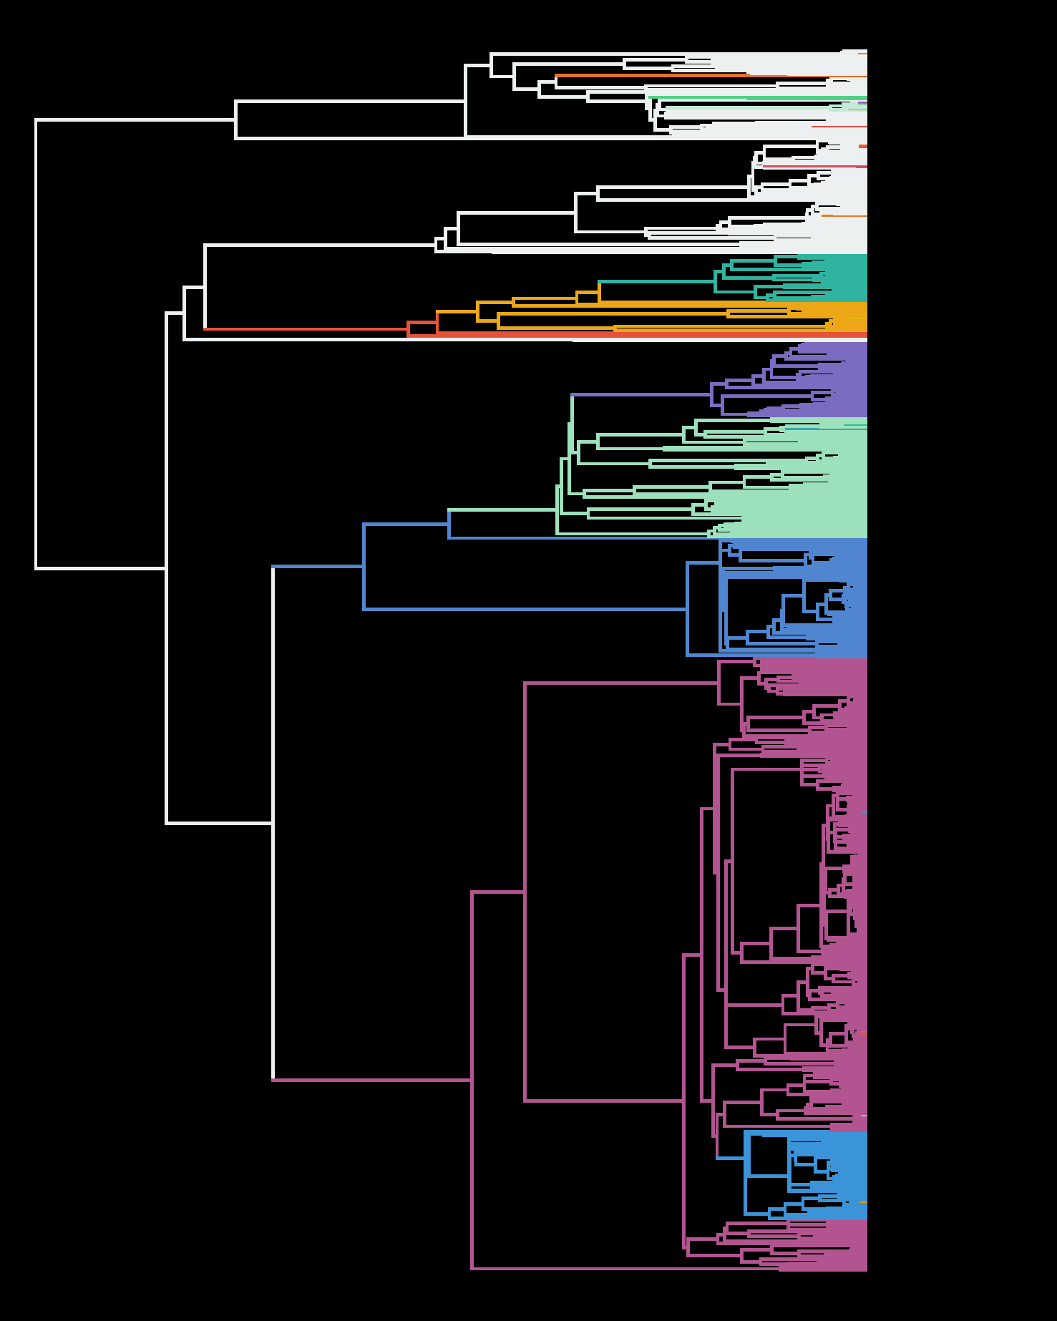


A Micro to Macroevolutionary Research program
.
.
.
.
.
.
.
.
PNH
Notes:
I’ve described some recent projects, as well as 3 proposals for which I’m currently seeking funding that all try to unite other sources of biological knowledge with phylogenetic comparative methods, really with the goal of understanding how adaptive landscapes change over macroevolutionary time. I see my research program sitting at the intersection of microevolutionary field studies and macroevolutionary phylogenetics. The availability of increasingly robust phylogenetic hypotheses allows us to do “phylogenetic natural history” using tools such as bayou to understand which clades are unique, and behaving differently. We can then target our study on those particular organisms, understand the biological processes underlying their change; and then scale these processes to macroevolutionary scales to see if they explain the diversity across the phylogeny. I’m very excited about the prospect of working here at Virginia tech because there are people doing such great work on interesting biological processes that have profound macroevolutionary implications. I think as someone with a hand in methods development, theory and empirical research, I would thrive working at the interface of these two scales at VT, and would envision having students and postdocs that not only worked on developing methods and theory, but also those interested in empirical questions and would build phylogenies in my lab or collaborations to apply process-based models to macroevolutionary data.

Slide 62
"No statistical procedure can substitute for thinking about alternative evolutionary scenarios and their plausibility" - Westoby et al. 1996

